Slide 1
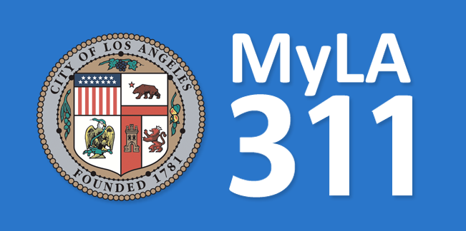


Data Analysis
Dec. 09, 2016
DSO 545- Group 5
› Shawn Hardesty
› Xinyu (April) Liang
› Jinhong Lu
› Yang Lu
› Patrick McDermott

Slide 2
Agenda
The Project
Tracking Data
Number of Calls
Resolution Categories
Service Failures
Correspondence between Area and Service
Request Data
Request Type Breakout
Status by Day of Week
Request Owner
Request Source
Admin. Area
Top ZIP Code Requests
Population Density Maps
Conclusion
Recommendations
Agenda
Tracking Data
Request Data
Conclusion
Questions

Slide 3

Tracking Data

Slide 4
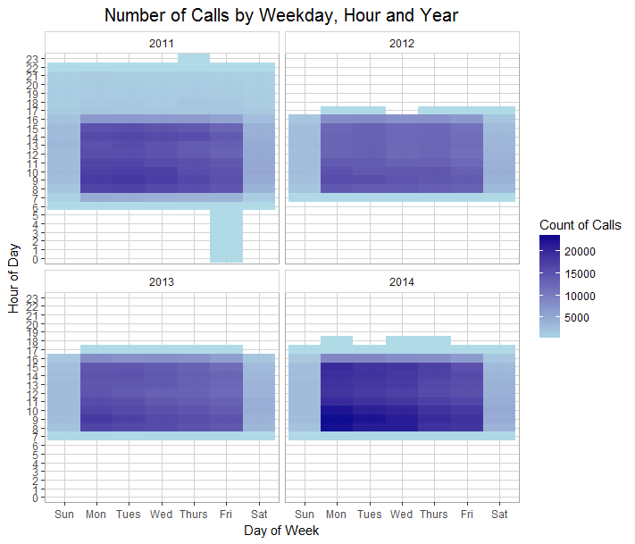
Number of Calls
A majority of calls are received between 8:00–11:00 a.m. and 2:00–3:00 p.m., especially Mondays through Wednesdays
Outliers in 2011
Longer call center hours (6:00 a.m.–10:00 p.m.)
Windstorm on Dec. 1st knocked out power from Thursday night to Friday morning
Agenda
Tracking Data
Request Data
Conclusion
Questions
Notes:
Most calls are received between 8:00–11:00 a.m. and 2:00–3:00 p.m., especially Mondays through Wednesdays
Calls received outside working hours in 2011: filtered the dataset and found almost all of them are due to one special outlier event: Los Angeles wind storm on Dec 1, 2011.
knocked out power to 340,000 people from Thursday night to Friday morning

Slide 5
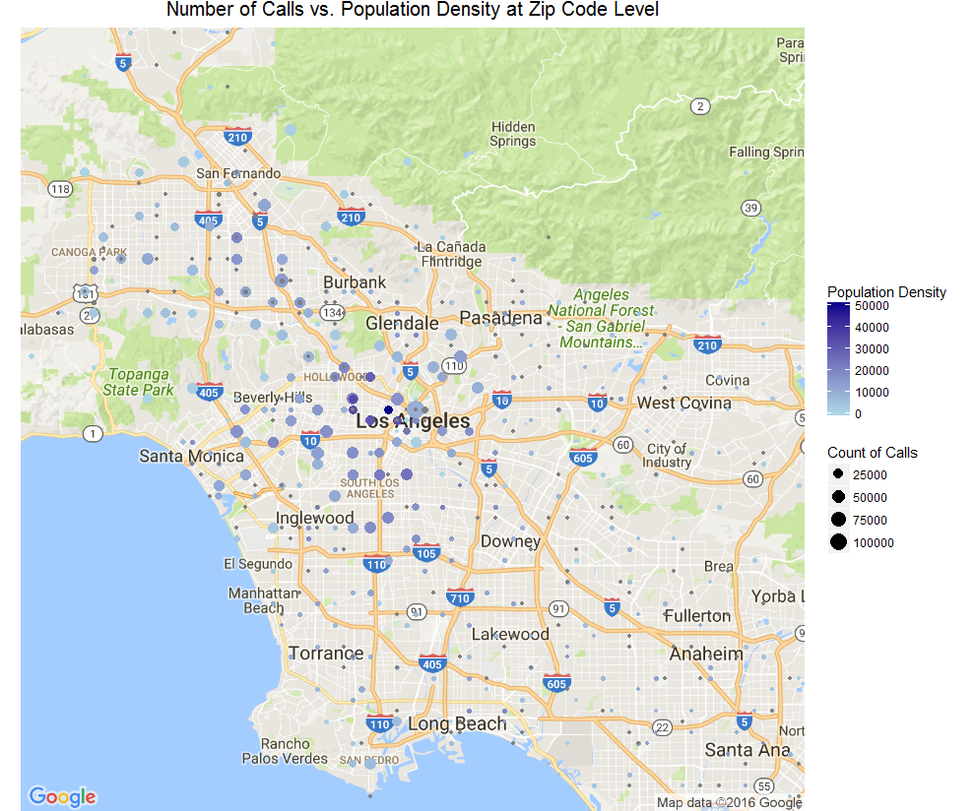
Number of Calls (Cont.)
There appears to be no correlation between the population density of a given ZIP code and the number of calls received by the city
That said, a majority of the calls look to be clustered around Central and South Los Angeles
Agenda
Tracking Data
Request Data
Conclusion
Questions
Notes:
(Size of dot represents number of calls in the zip code area; Color of dot represents population density in that zip code area)
Large number of calls in South Los Angeles and downtown area, which is probably due to high population density.
Although population density is relatively low in northwest area, there are many calls associated with that zip code.

Slide 6
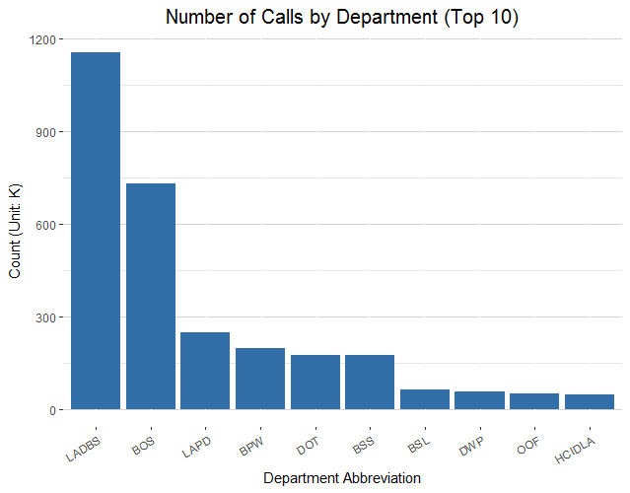
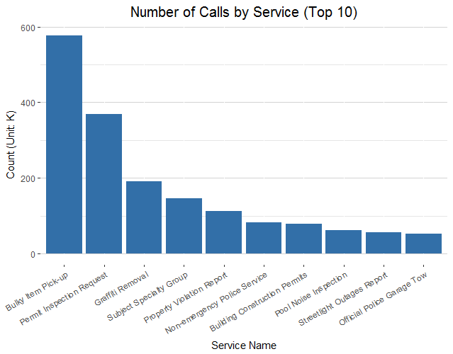
Number of Calls (Cont.)
Agenda
Tracking Data
Request Data
Conclusion
Questions
Notes:
Left: LADBS (LA Department of Building and Safety) has the highest number of calls, followed by BOS (Bureau of Sanitation) and LAPD (LA Police Department).
Right: Among all the services associated with calls, bulky item pick-up has highest demand, followed by request of permit inspection and graffiti removal

Slide 7
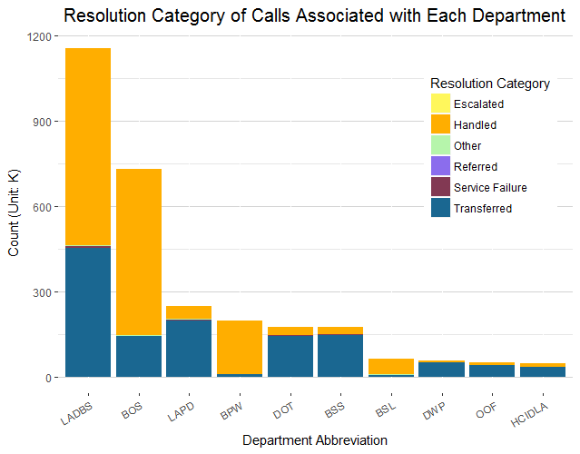
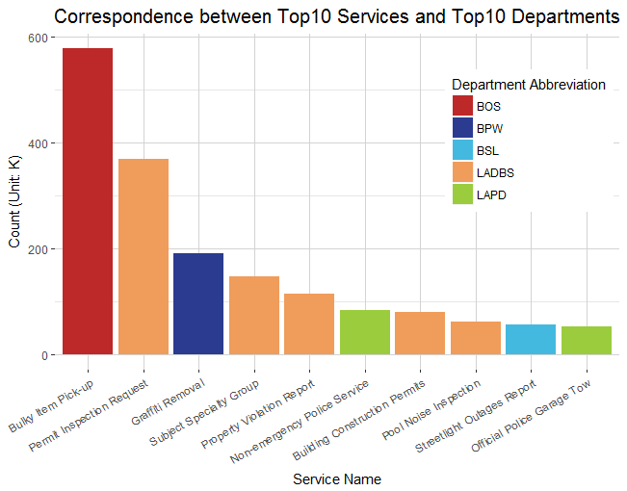
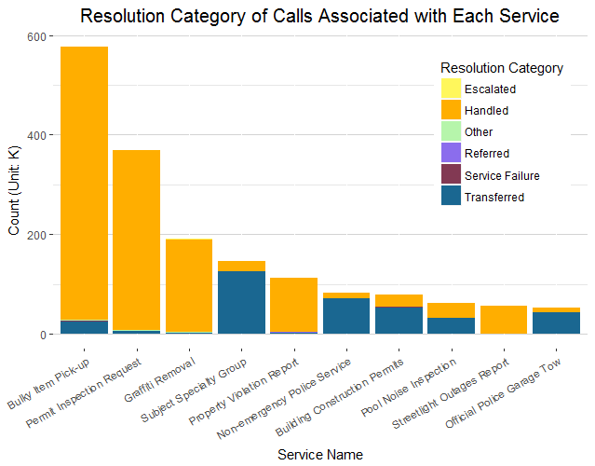
Resolution Categories
Agenda
Tracking Data
Request Data
Conclusion
Questions
Notes:
Left: Some departments have high percent (or number) of transferred calls. What’s the cause?
Top right: Resolution category of calls associated with each service. We can see that calls related to Subject specialty group, Non-emergency police service, Building construction permit, Pool noise inspection etc. have high transfer rate.
Bottom right: High transfer rate of some departments are probably due to the high transfer rate of the services that they deal with. E.g. LADBS is associated with services that has high transfer rate (Subject specialty group, Building construction permit, Pool noise inspection).
Recommendation:
=======
Resolution categories
"Handled“: "Call Resolution", "Gave Caller Information", "Service Request Processed"
"Referred“: "Referred To 411", "Referred To County", "Referred To Other Governmental", "Referred To State"
"Service Failure“: "Got Voicemail (City)", "Info Not Available (Non-City)", "Line Busy (City)"
"Transferred“: "Transfer (City)","Transferred To 411","Warm Transfer (City)"
"Escalated“: "Escalate To Supervisor", "Escalated To Office of Finance“
"Other“: “Static/Ghost Call”, “Caller Hung Up”, “N/A”

Slide 8
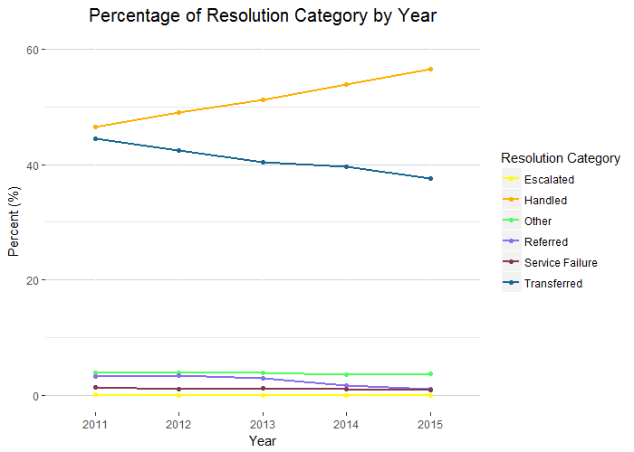
Resolution Categories (Cont.)
Since 2011, the number of calls handled has increased significantly, while the number of calls transferred has decreased at the same rate.
Agenda
Tracking Data
Request Data
Conclusion
Questions
Notes:
Good news – from 2011 to 2015, the percentage of handled cases increased significantly, while percentage of transferred calls reduced. Service rate has slightly reduced.

Slide 9
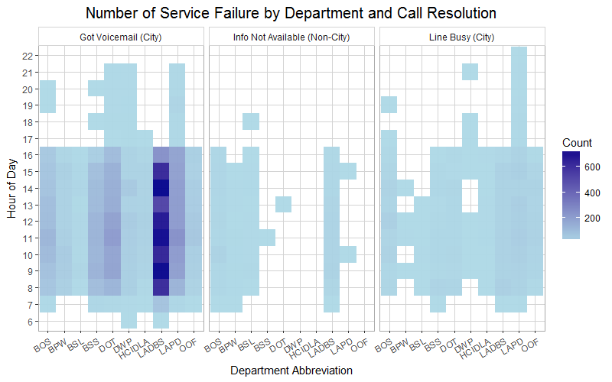
Service Failures
LAPD, DWP, and DOT have similar call and service failure volumes, and are busiest at the most diverse hours
LADBS has the highest volume of calls and service failures
Agenda
Tracking Data
Request Data
Conclusion
Questions
Notes:
Not surprisingly, service failures are more likely to occur during office hours.
‘Got Voicemail’ is the top factor leading to service failure.
LADBS has highest number of service failures.
This makes sense because LADBS’s call volume almost doubles that of any other department (slide 4)
The LAPD appears to be the busiest department as their line is busy most frequently and at the most diverse hours
Similarly, the DWP and DOT experience calls at more diverse hours than other departments
This is likely because water, power, and transportation issues are the most urgent for citizens of LA County. Most people aren’t calling for building permits at 11:00 p.m.
Recommendation – special hotlines for frequently called departments to reduce rate of service failure
LADBS
DOT
DWP
LAPD

Slide 10
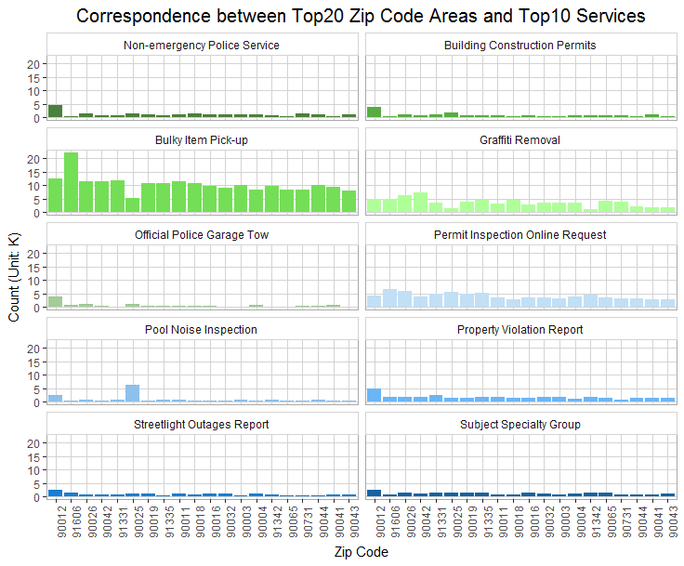
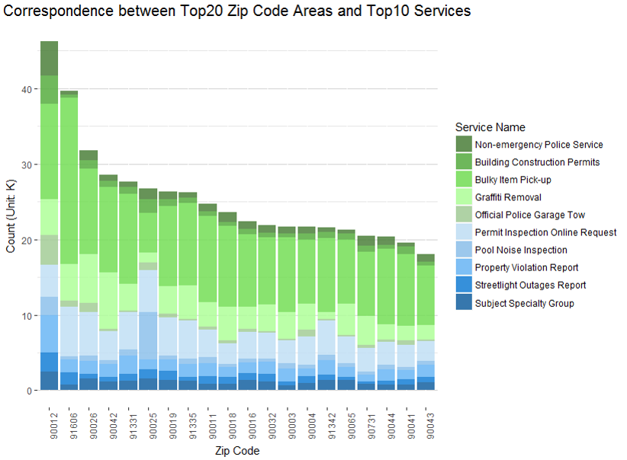
Correspondence between Area and Service
Agenda
Tracking Data
Request Data
Conclusion
Questions
Notes:
90012 (Chinatown) has highest number of requests, followed by 91606 (North Hollywood), 90026 (Silver Lake and Echo Park), 90042 (Highland Park), etc
Noticeable things:
90012 (Chinatown): lots of Non-emergency Police Service & Building Construction Permits & Report of Property Violation
It has extremely large pop density; The majority of household are rented
91606 (North Hollywood): lots of bulky item pick-up
90042 (Highland Park): Graffiti removal – 90012 the number of young adults is large
90025 (West LA): pool noise inspection – 90025 one of the nicer parts of town with a more affluent demographic

Slide 11
Request Data

Slide 12
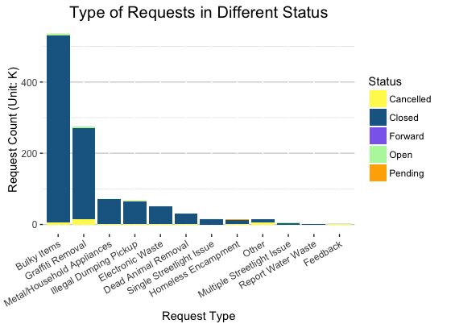
Request Type Breakout
Top items
Bulky Items
Graffiti Removal
Metal/Household Apps.
Only a small percentage of requests are not closed.
Graffiti most cancelled.
Agenda
Tracking Data
Request Data
Conclusion
Questions
Notes:
The Top 3 types of request are Bulky Items, Graffiti Removal, Metal/Household Appliances. And as for the different status, we can see that most of the cases have been closed, the cancelled requests happened most in Graffiti Removal (rank No.2 in the request types instead of No.1).
Recommendation: Start a special express line for Bulky Items Removal requests and assign more staff to this section because this category is highly needed.

Slide 13
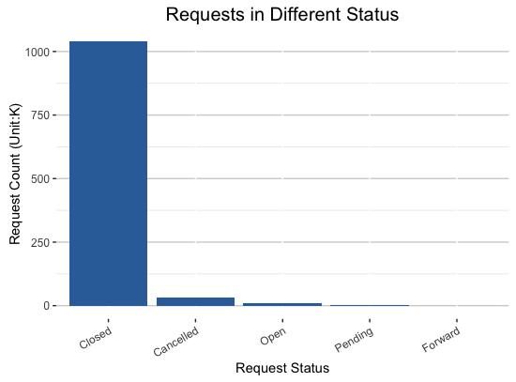
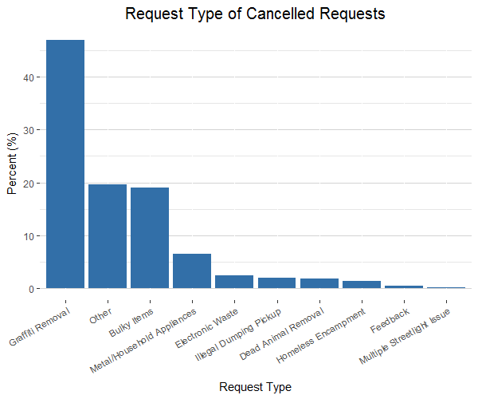
Request Type Breakout (Cont.)
Agenda
Tracking Data
Request Data
Conclusion
Questions
Notes:
Breaking out the graph, you can see almost all the requests are closed. Because of the in detail in how requests are entered, rarely are requests forwarded, which is a very good sign for efficiency. Graffiti Removal is the most cancelled request at 45% of all cancellations. This may be due to multiple people reporting the same graffiti.

Slide 14
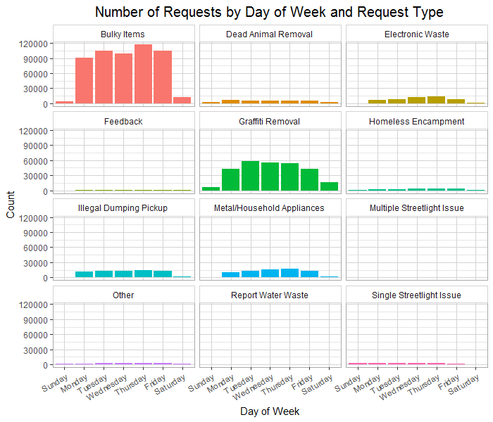
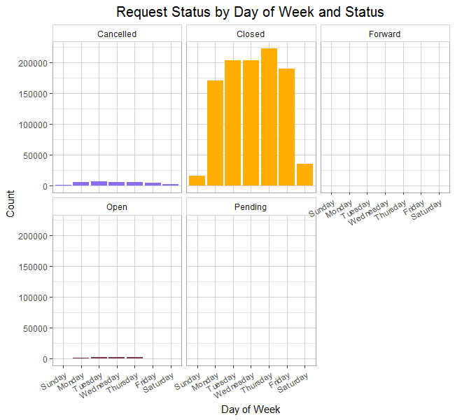
Status by Day of Week
Agenda
Tracking Data
Request Data
Conclusion
Questions
Notes:
We were trying to find a pattern in requests for the days of the week, but as you can see, there wasn’t any major pattern for any requests. Throughout the week, all requests are pretty sporadic. You also may assume that more requests were opened earlier in the week (because of the weekend), but there was also not much evidence supporting this.

Slide 15
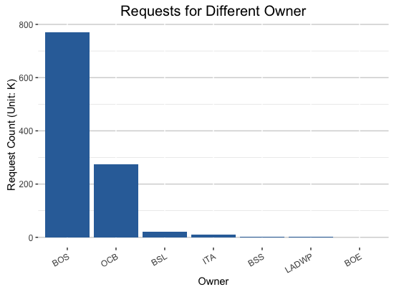
Request Owner
The top three owners of requests are BOS, OCB, and BSL, which corresponds to the results from the Tracking dataset.
Agenda
Tracking Data
Request Data
Conclusion
Questions
Notes:
The Top 3 requests for Different Owners are: BOS, OCB, BSL, which in some level corresponds to the results got from Tracking data.

Slide 16
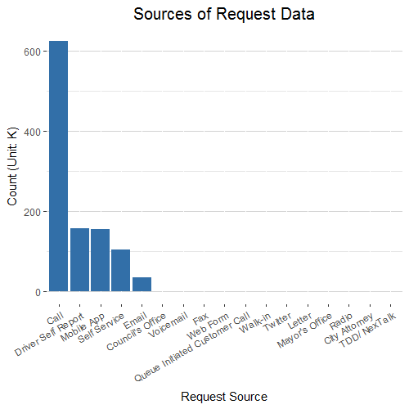
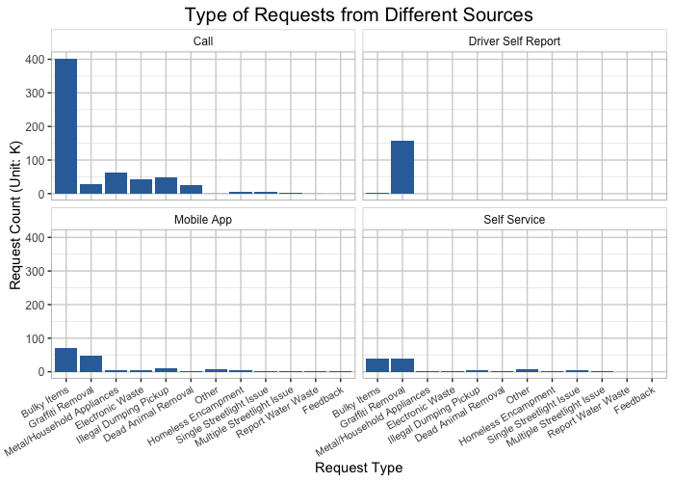
Request Source
Agenda
Tracking Data
Request Data
Conclusion
Questions
Notes:
There are plenty of sources to make a request, the Top 3 popular source for people to make a request are: Call, Drive Self Report, Mobile App.
Interesting findings:
The most common way for people to make a request is to call the number, and the services are various in different request types.
When it comes to Graffiti Removal, People tend to choose to drive themselves to report instead of other available ways (such as call or Mobile app or self Service)
When it comes to the type of Bulky Items, people tend to make calls, which seems like the easiest w

Slide 17
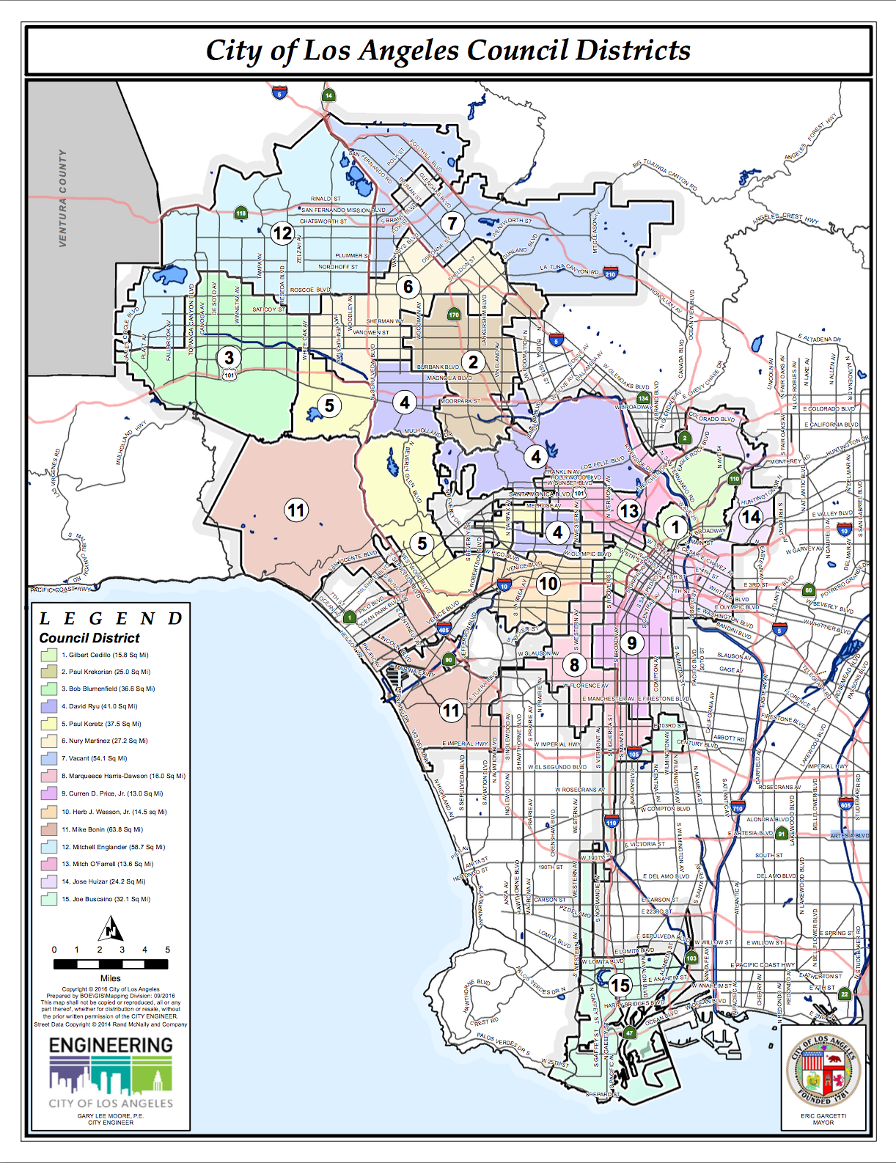
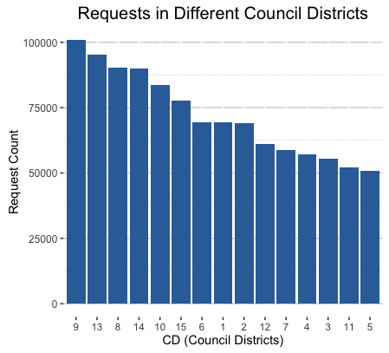
Admin Area
Most requests:
Districts 9, 13, 8
Areas of Central LA, South LA, South Valley
South and Central LA see the most requests.
More populated area
Agenda
Tracking Data
Request Data
Conclusion
Questions
Notes:
The top three APCs which generate the most requests: South LA, Central, South Valley APC, which are confirmed with common sense.
And according to the map of Los Angeles Council Districts, the Council Districts that have most requests like 9, 13, 8 are some where in the south Los Angeles, which can draw the identical conclusions about the Admin Area VS. requests: South Los Angeles is a pain in the ass.

Slide 18
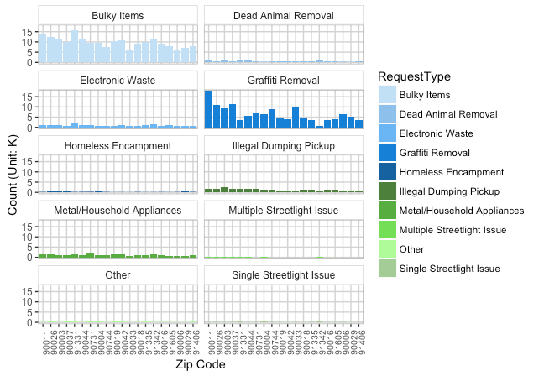
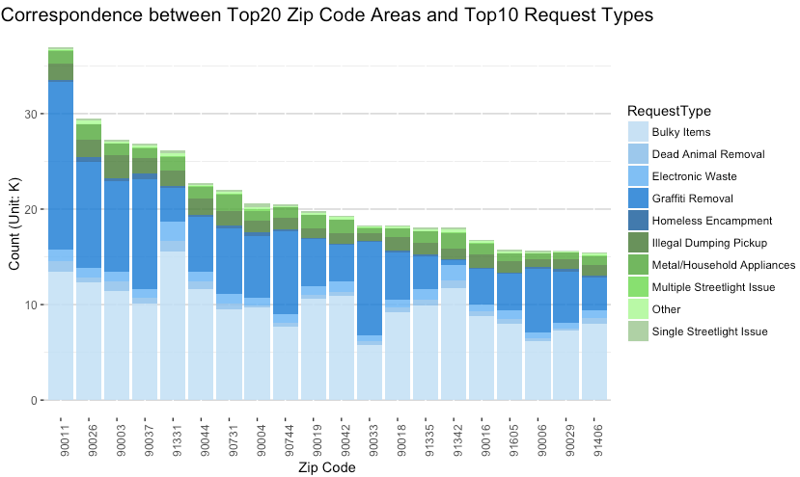
Top ZIP Code Requests
Agenda
Tracking Data
Request Data
Conclusion
Questions
Notes:
Different requests showing in top 20 zip code:
2 Interesting findings:
##1. Abnormally large amount of requests of Bulky Items and Electronic Waste in zip code 91331 : Pacoima. (“has an extremely large population density” quote from “www.unitedstateszipcodes.org/91331/”
##2. Abnormally large amount of requests of Graffiti Removal in zip code 90011: Central Alameda. “ZIP code 90011 is located in south California and covers a slightly less than average land area compared to other ZIP codes in the United States. It also has an extremely large population density.
The people living in ZIP code 90011 are primarily other race. The number of people in their late 20s to early 40s is extremely large while the number of young adults is large. There are also an extremely large number of single parents and an extremely small number of single adults. The percentage of children under 18 living in the 90011 ZIP code is extremely large compared to other areas of the country.” quote from “http://www.unitedstateszipcodes.org/90011/”

Slide 19
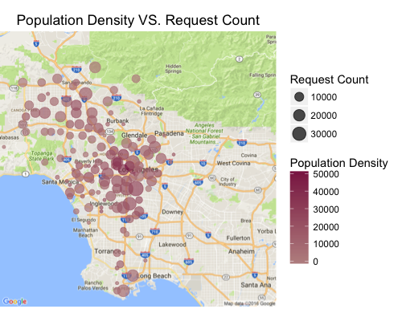
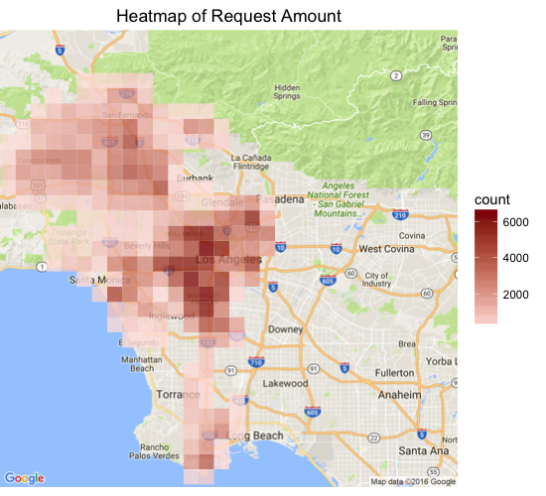
Population Density Maps
Agenda
Tracking Data
Request Data
Conclusion
Questions
Notes:
Requests happened most in the Central LA, South LA and Korean Town.
Higher the Population density, larger the number of requests (In general)

Slide 20
Conclusion

Slide 21

Recommendations
Dedicated hotlines for frequently called departments to reduce service failures
LADBS
LAPD
DOT
DWP
BOS
Removal of bulky Items is the most requested service
Encourage use of mobile app
Certain areas have specific service requests; use the past trends to plan city infrastructure accordingly
Agenda
Tracking Data
Request Data
Conclusion
Questions
Notes:
LADBS has highest number of service failures.
This makes sense because LADBS’s call volume almost doubles that of any other department (slide 6)
The LAPD appears to be the busiest department as their line is busy most frequently and at the most diverse hours
Similarly, the DWP and DOT experience calls at more diverse hours than other departments
This is likely because water, power, and transportation issues are the most urgent for citizens of LA County. Most people aren’t calling for building permits at 11:00 p.m.
Recommendation – special hotlines for frequently called departments to reduce rate of service failure
LADBS
LAPD
DOT
DWP
BOS
Removal of bulky Items is the most requested service

Slide 22
Questions?

